Slide 1

Bachelor of Technology
Capstone Project Final Review Presentation
Academic Year 2023-24
Semester XII
SVKM’s NMIMS
Mukesh Patel School of Technology Management and Engineering, Vile Parle, Mumbai- 400056
Department of Electronics & Telecommunication
1

Slide 2
A PRESENTATION ON
“Smart Health Monitoring System”
By
Lackshya Mathur, D003, SAP ID 70331018003
Nirvan Tamhane, D007, SAP ID 70331018005
Under the guidance of
Dr. Manoj Sankhe
2

Slide 3
Table of Contents
Objectives
Introduction
Motivation
Literature Survey
Problem Statement
Block Diagram
Hardware and Software requirements
Methodology
References
Acknowledgement
3

Slide 4
Objectives
Develop a Smart Health Monitoring System integrating advanced hardware components for real-time monitoring of vital signs (heart rate, SpO2, temperature, sleep patterns, room conditions).
Enable remote access to patient data through a user-friendly mobile app developed on Flutter and powered by Firebase's real-time database.
Ensure seamless integration of hardware modules, including display and sensor bands, for efficient data collection and transmission.
Mimic the interface of hospital patient monitors in the mobile app to streamline user interaction and reduce the learning curve for healthcare professionals.
Facilitate comprehensive patient care by providing instant access to patient charts and medical documents (e.g., X-ray, MRI, blood reports) within the app.
Empower healthcare providers with timely insights into patient health metrics, enabling informed decision-making and improving overall patient outcomes.
4

Slide 5
Introduction
Our project unveils a groundbreaking Smart Health Monitoring System designed to revolutionize healthcare practices.
With real-time tracking of vital signs and remote accessibility to patient data, we aim to address the growing demand for efficient healthcare solutions.
Leveraging advanced hardware components and a user-friendly mobile app developed on Flutter, our system offers seamless integration and intuitive user experience.
By emulating the interface of hospital patient monitors, we prioritize ease of use, ensuring healthcare professionals can navigate effortlessly through patient data.

Slide 6
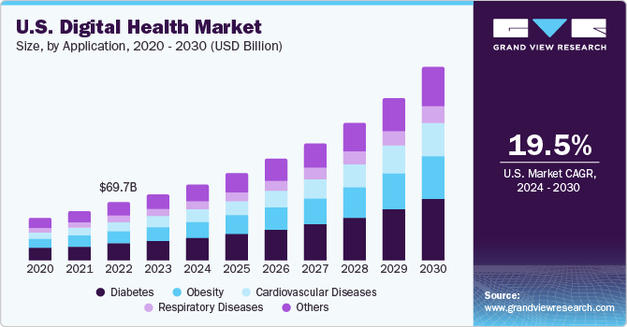
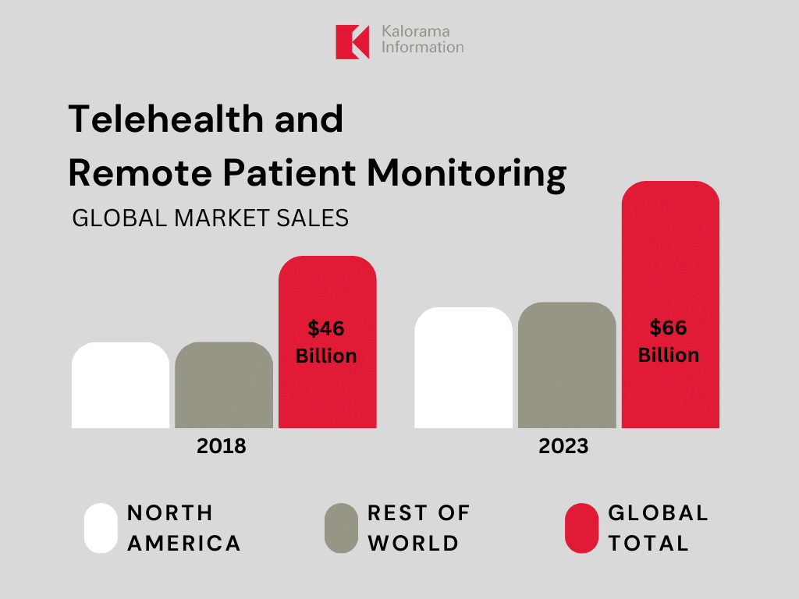
Motivation
Remote healthcare demand: Addressing the need for remote healthcare solutions.
Healthcare technology integration: Merging traditional healthcare with modern technology.
Professional empowerment: Equipping healthcare professionals with vital tools and information.
Social impact of healthcare innovation: Driving positive change in healthcare accessibility and standards.

Slide 7
Literature Survey
[1]"Efficacy of Wearable Devices in Cardiovascular Health Monitoring.“
Objective Assessment: The study evaluates the effectiveness of wearable devices in monitoring cardiovascular health, providing an objective assessment of their utility in this domain.
Methodological Approach: Smith et al. employ a rigorous methodological approach to investigate the efficacy of wearable devices, ensuring reliability and validity of their findings.
Findings: The findings suggest promising results regarding the ability of wearable devices to monitor cardiovascular health parameters such as heart rate, blood pressure, and physical activity levels.
Implications: The study's results have significant implications for healthcare practitioners and individuals seeking to monitor and manage their cardiovascular health, potentially leading to improved monitoring and preventive interventions.

Slide 8
Literature Survey
[2]"Wearable Sensors for Sleep Monitoring: A Review.’”
Comprehensive Review: The article provides a comprehensive review of wearable sensors designed for sleep monitoring, offering insights into the advancements and limitations of such technologies.
Evaluation of Sensor Technologies: Jones et al. critically evaluate various sensor technologies utilized in wearable devices for sleep monitoring, including accelerometers, photoplethysmography (PPG) sensors, and electroencephalography (EEG) sensors.
Assessment of Accuracy and Reliability: The authors assess the accuracy and reliability of wearable sensors in capturing sleep-related parameters such as sleep stages, sleep duration, and sleep quality, shedding light on the performance of these devices in real-world settings.
Clinical and Research Implications: The review discusses the clinical and research implications of wearable sleep monitoring devices, highlighting their potential utility in diagnosing sleep disorders, tracking treatment outcomes, and advancing sleep research.

Slide 9
Literature Survey
[3] "Wearable Health Monitoring Technologies for Elderly Care: A Systematic Review.“
Systematic Review Approach: Chen et al. conduct a systematic review to comprehensively assess wearable health monitoring technologies aimed at elderly care, ensuring a thorough examination of the available literature in this field.
Evaluation of Wearable Devices: The authors critically evaluate a range of wearable devices designed for health monitoring in the elderly population, examining their effectiveness in monitoring vital signs, physical activity, and other health-related parameters.
Technological Advancements: The review discusses technological advancements in wearable health monitoring devices tailored for elderly care, such as miniaturization, wireless connectivity, and integration of advanced sensors for improved accuracy and user experience.
Practical Implications: Chen et al. discuss the practical implications of wearable health monitoring technologies for elderly care, including their potential to enhance remote monitoring, early detection of health issues, and support for independent living among elderly individuals.

Slide 10
Literature Survey
[4]"Continuous Glucose Monitoring Using Wearable Sensors in Diabetes Management: A Review “
In-depth Review: The paper offers a comprehensive review of wearable sensor technology for continuous glucose monitoring, focusing on its role in diabetes management.
Technology Evaluation: Wang et al. assess the effectiveness of wearable sensors in providing continuous glucose monitoring, examining their accuracy and reliability in real-world scenarios.
Advancements Highlighted: The review highlights advancements in wearable sensor technology, such as improved accuracy, miniaturization, and integration with mobile apps for better diabetes management.
Clinical Implications: Discusses the clinical implications of continuous glucose monitoring using wearable sensors, including its potential to enhance glycemic control, reduce hypoglycemic events, and improve quality of life for individuals with diabetes.

Slide 11
Literature Survey
[5]"Wearable Sensors and Artificial Intelligence for Early Detection of Health Abnormalities: A Review “
Comprehensive Review: The paper provides a thorough review of wearable sensors and AI technologies for early detection of health abnormalities.
Technology Integration: It explores the integration of wearable sensors with AI algorithms to enable early detection of various health conditions.
Advantages Highlighted: The review emphasizes the advantages of combining wearable sensors and AI, such as real-time monitoring, personalized health insights, and timely intervention.
Clinical Significance: Discusses the clinical significance of early detection enabled by these technologies, potentially leading to improved health outcomes and reduced healthcare costs.

Slide 12
Problem Statement
Limited Remote Monitoring: Traditional healthcare systems lack efficient remote monitoring capabilities, hindering timely interventions and patient care outside clinical settings.
Data Accessibility Challenges: Accessing comprehensive patient data and medical records remotely is often cumbersome and inefficient, impeding healthcare professionals' ability to make informed decisions.
Technological Disconnect: Existing healthcare systems often fail to integrate modern technology effectively, resulting in fragmented data collection and limited accessibility for professionals and patients alike.
Healthcare Inequities: Disparities in healthcare access and quality persist, particularly in remote or underserved areas, highlighting the urgent need for innovative solutions to improve healthcare accessibility and standards.

Slide 13
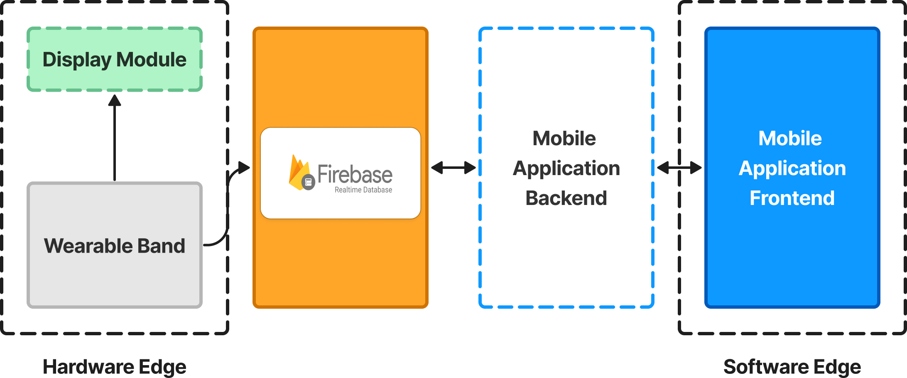
Block Diagram

Slide 14
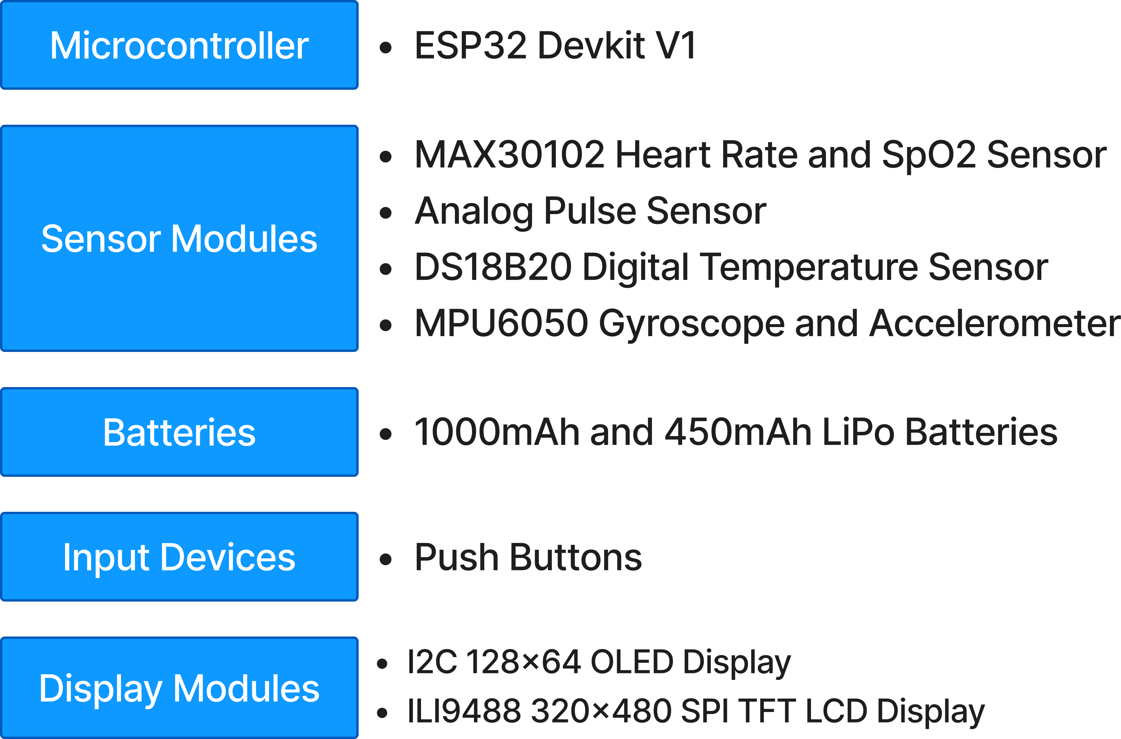
Hardware & Software Requirements
Hardware Requirements
14

Slide 15



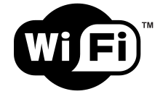


Hardware & Software Requirements
Software Requirements
Arduino IDE
Development Environment for programming microcontrollers
Firebase
Firebase Realtime Database for storing and retrieving patient data
C++
Programming Languages for microcontroller programming
Wi-Fi
Protocol for communication between hardware modules and the mobile app
Flutter
Framework for cross-platform mobile app development
Figma
To design User-Interface of the app and UX of the app and test it for usability
15

Slide 16
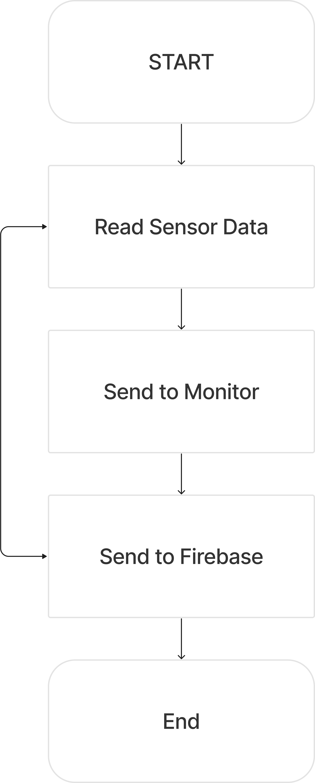
Flowchart

Slide 17
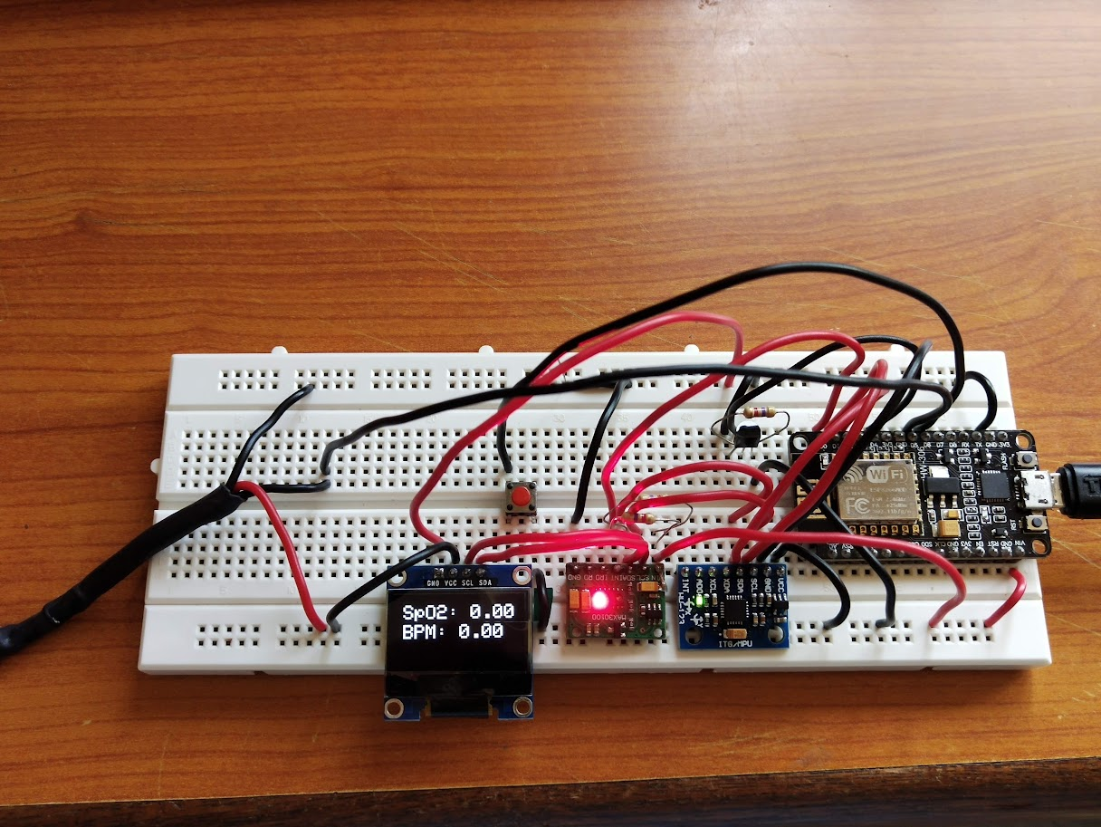
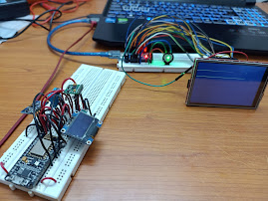
Methodology
Requirement Analysis:
Identify and prioritize project requirements based on stakeholder needs and objectives.
Define scope, functionalities, and performance criteria for the Smart Health Monitoring System.
Prototype Development:
Create prototypes for hardware and application components.
Conduct rigorous testing for functionality assurance.
Acquire knowledge of system programming and configuration procedures.

Slide 18
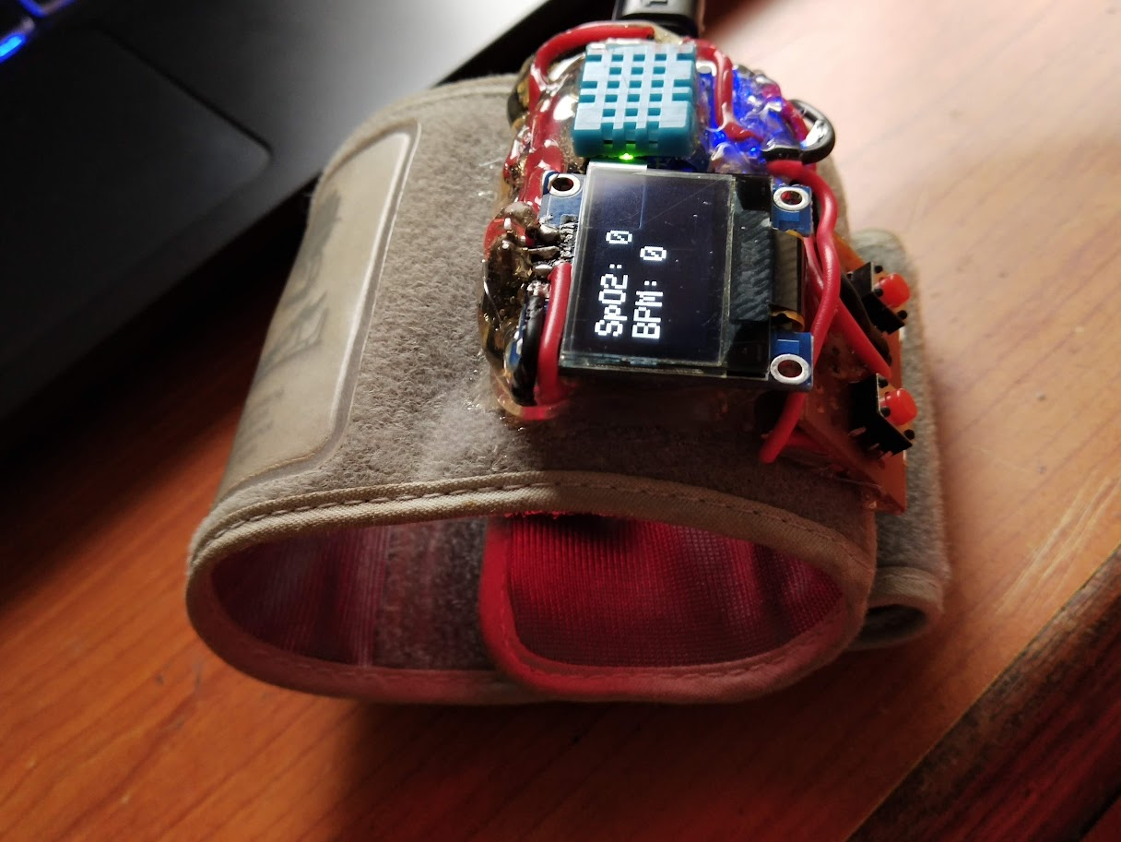
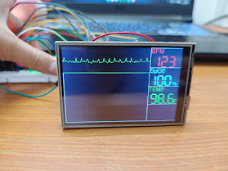
Methodology
Hardware and Firmware Design
and Development:
Selected suitable components post-prototyping.
Started hardware and firmware development, including programming and assembly.
Conducted simultaneous testing to ensure proper functioning and implemented software-based preprocessing.
Tested data reliability for functionality assurance.
Integrated with Firebase RTD using Wi-Fi protocol.

Slide 19
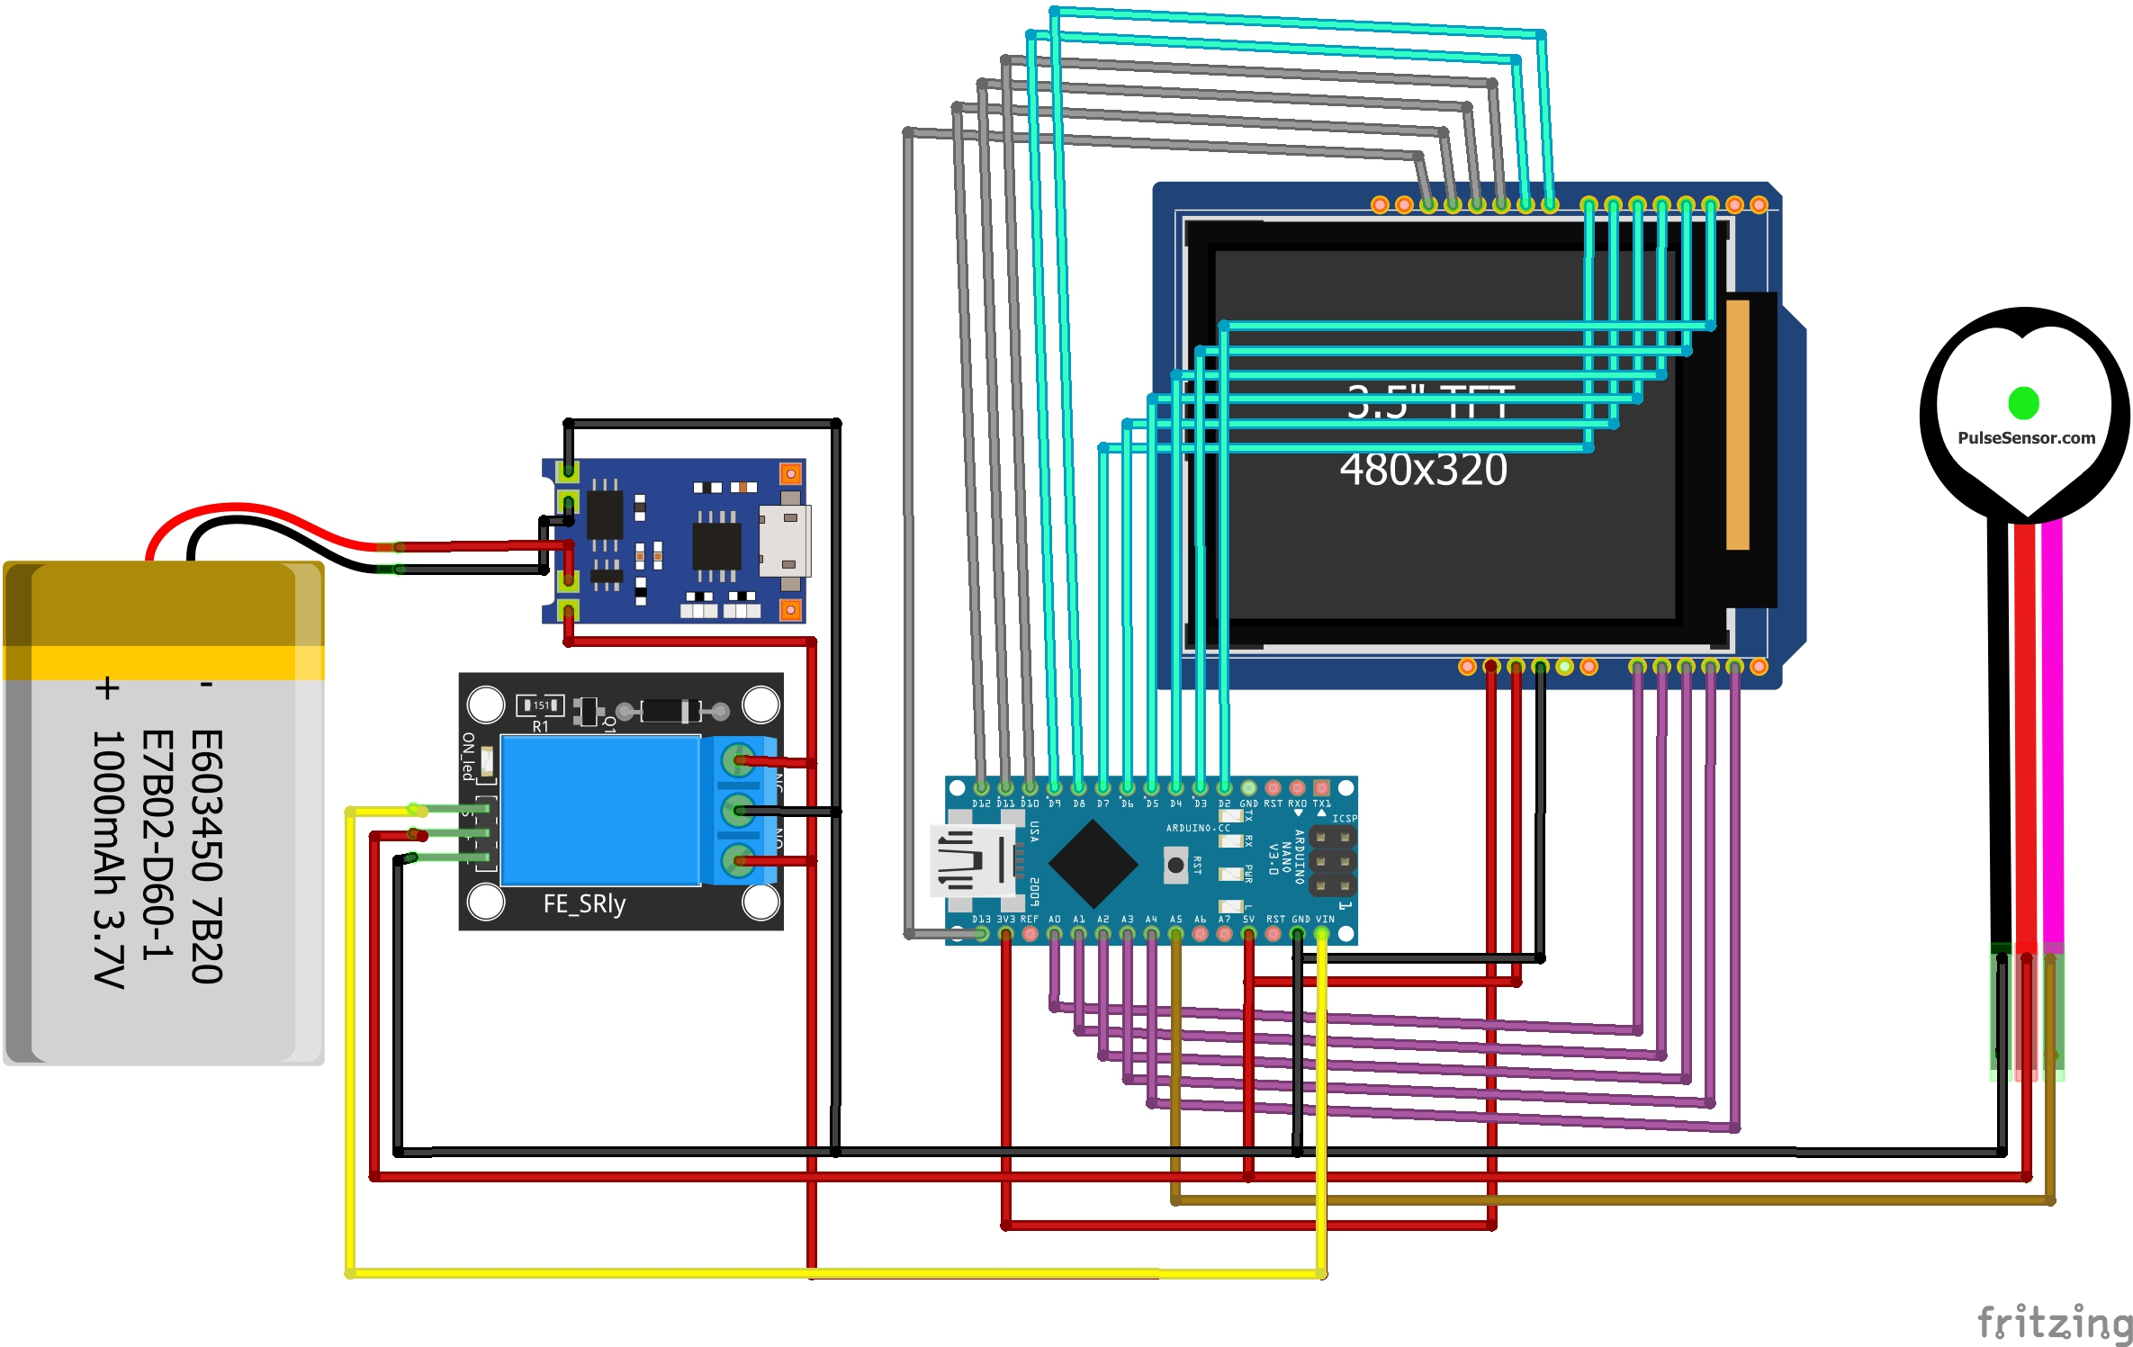
Methodology
Schematic Diagram:

Slide 20
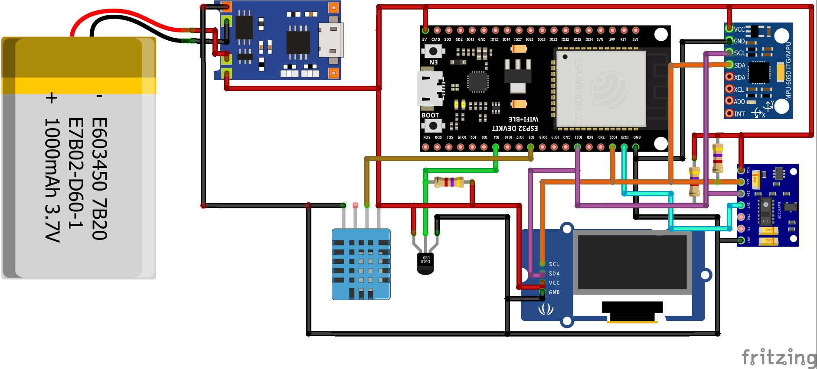
Methodology
Schematic Diagram:

Slide 21
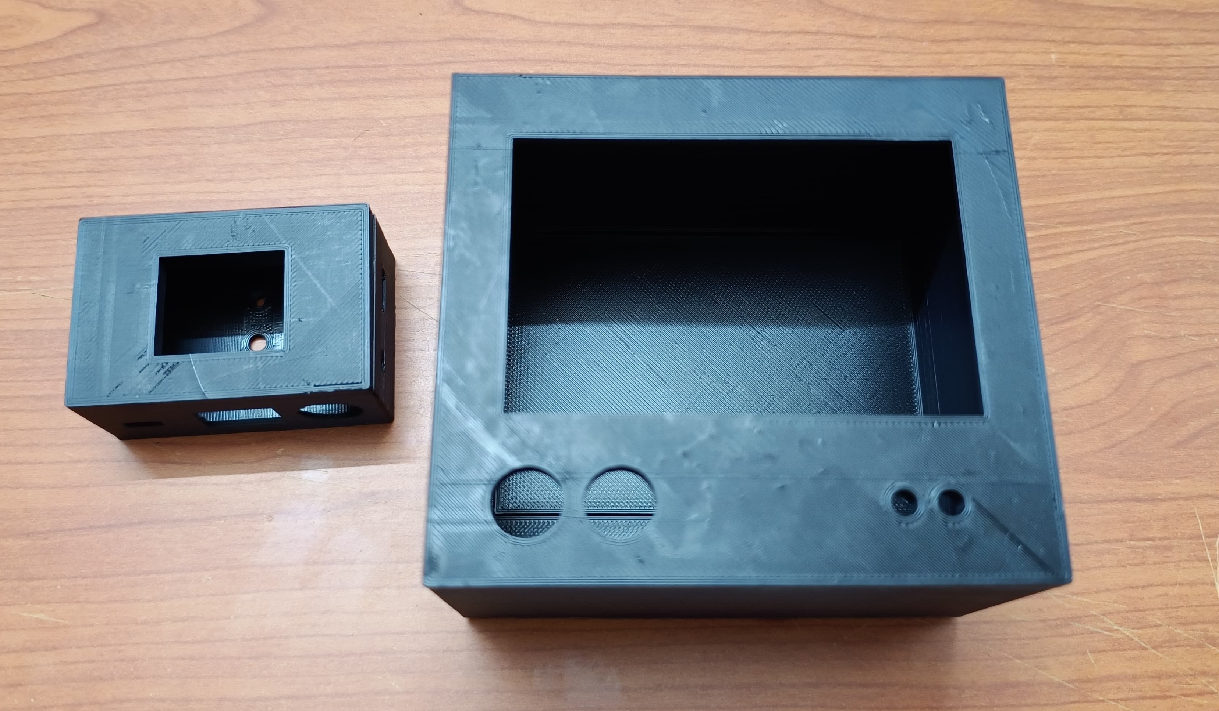
Methodology
3D Printed Hardware Enclosures:

Slide 22
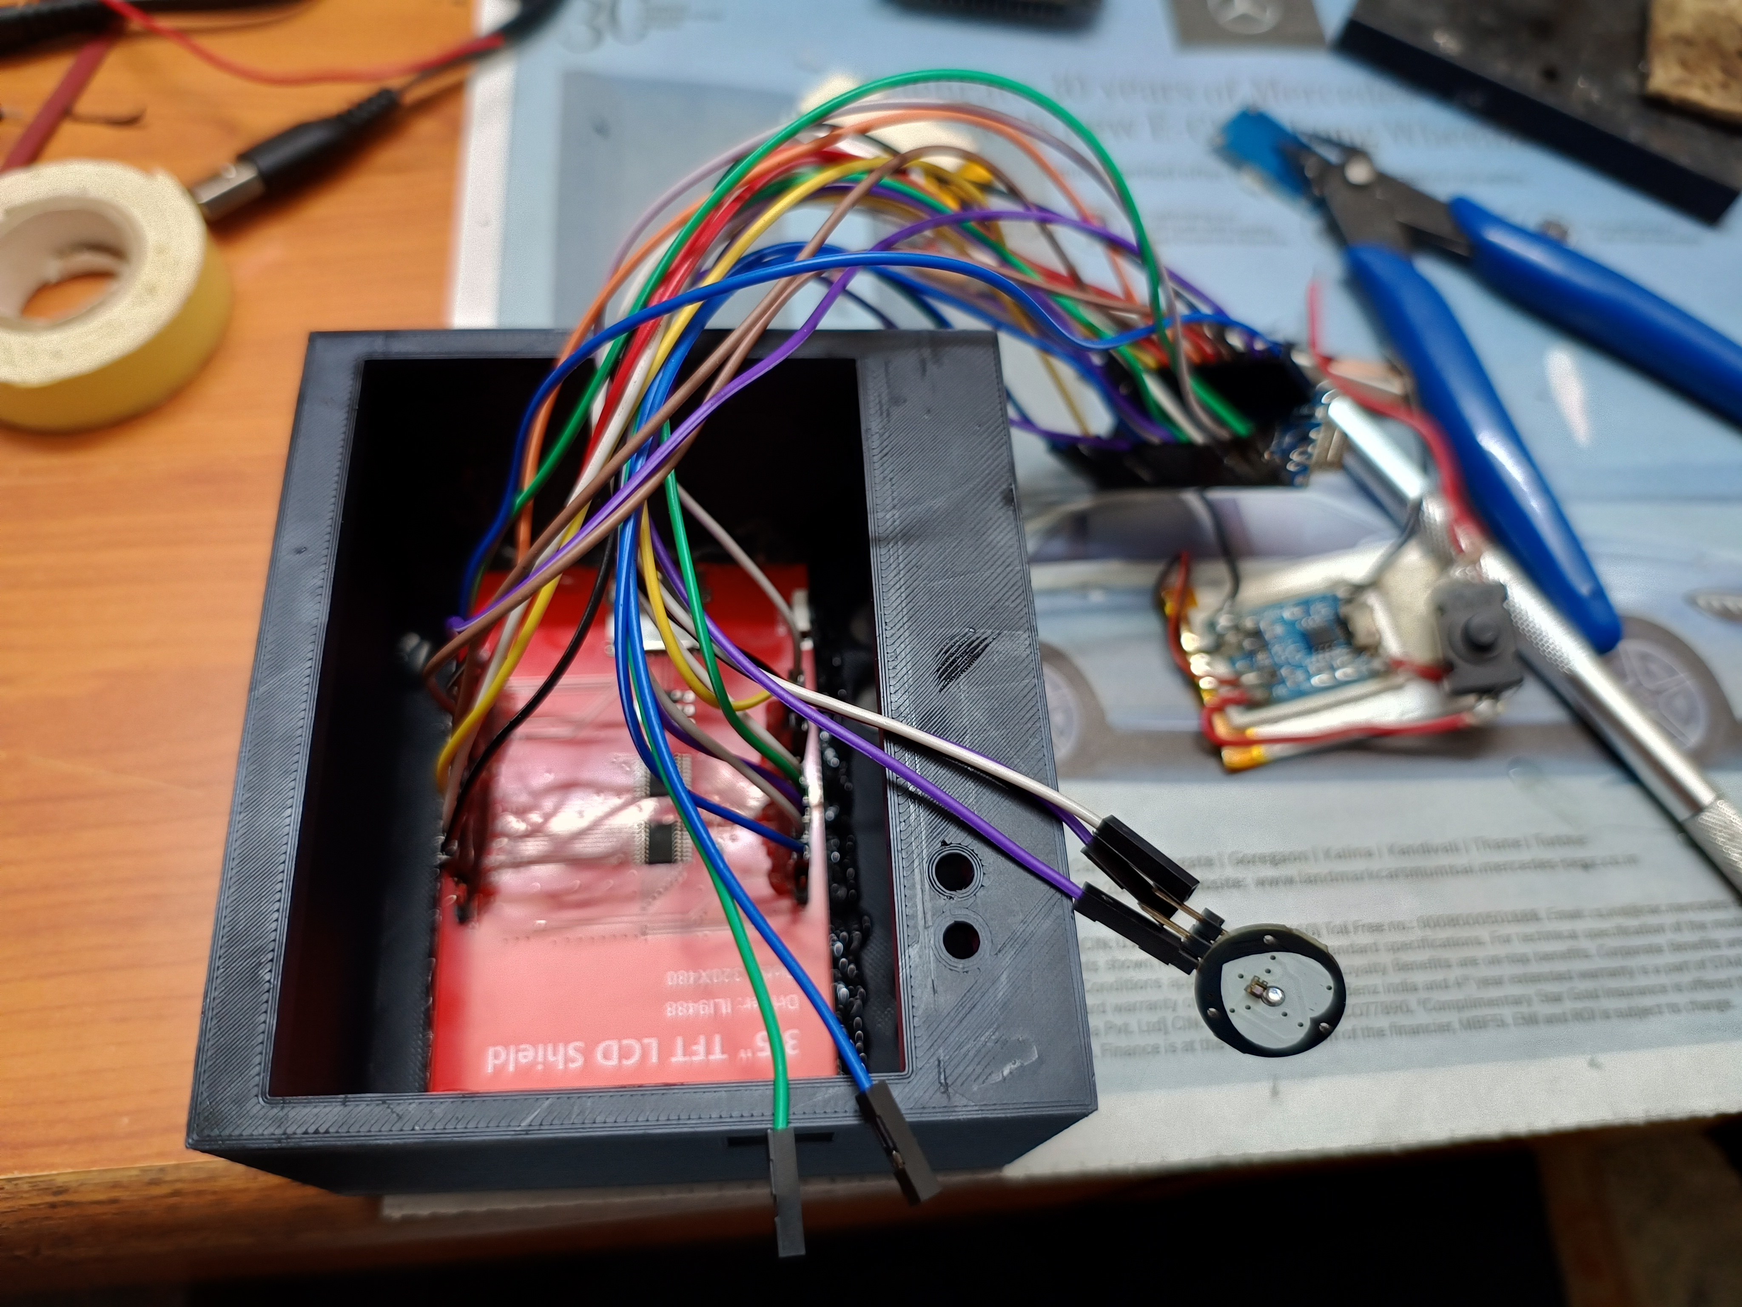
Methodology
3D Printed Hardware Enclosure Assembly:

Slide 23
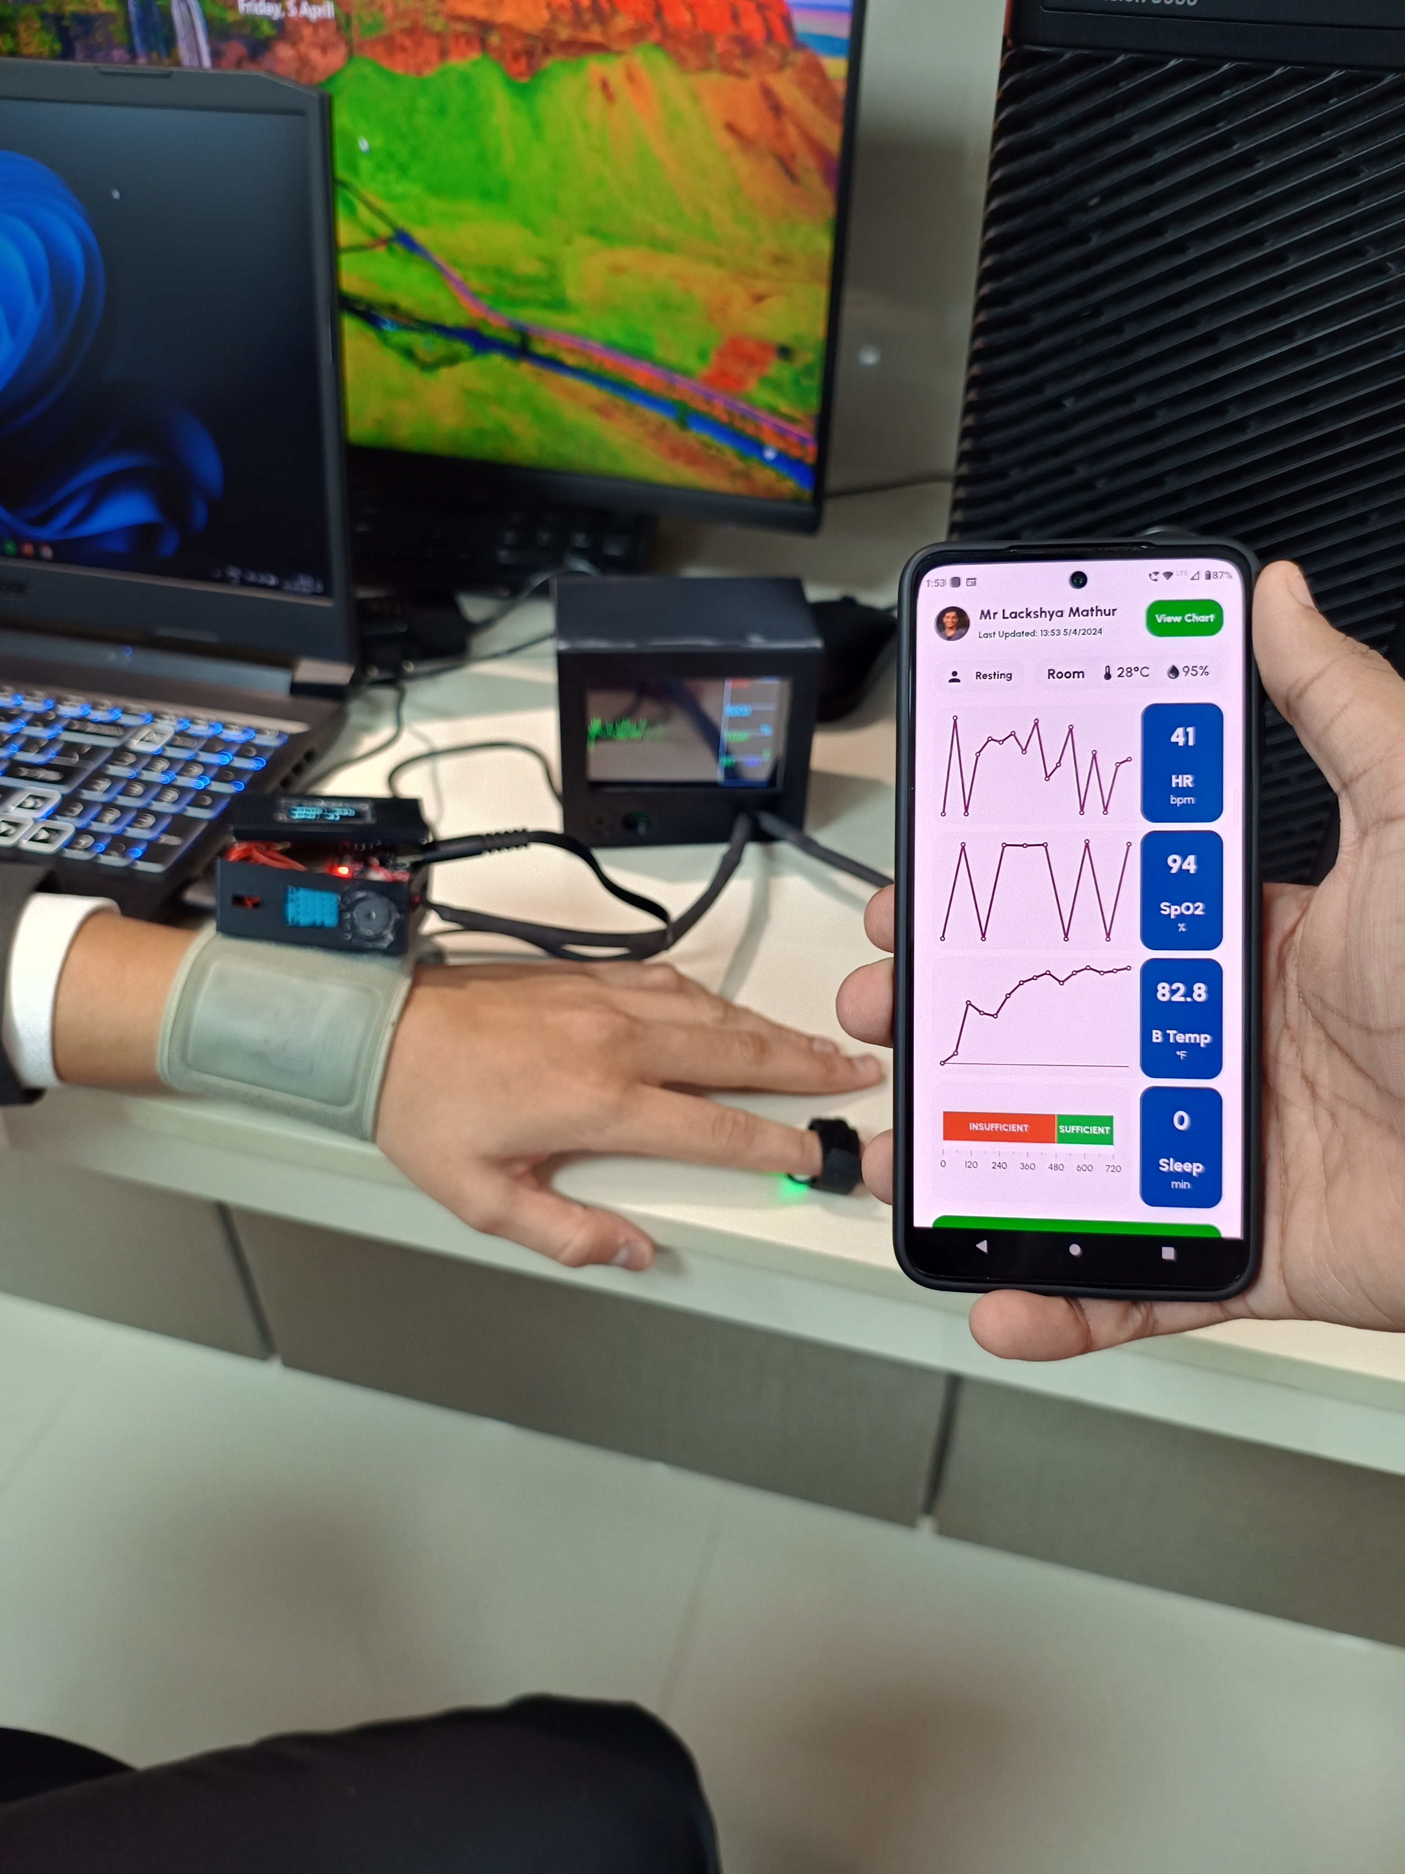
Methodology
Integrated Testing:

Slide 24
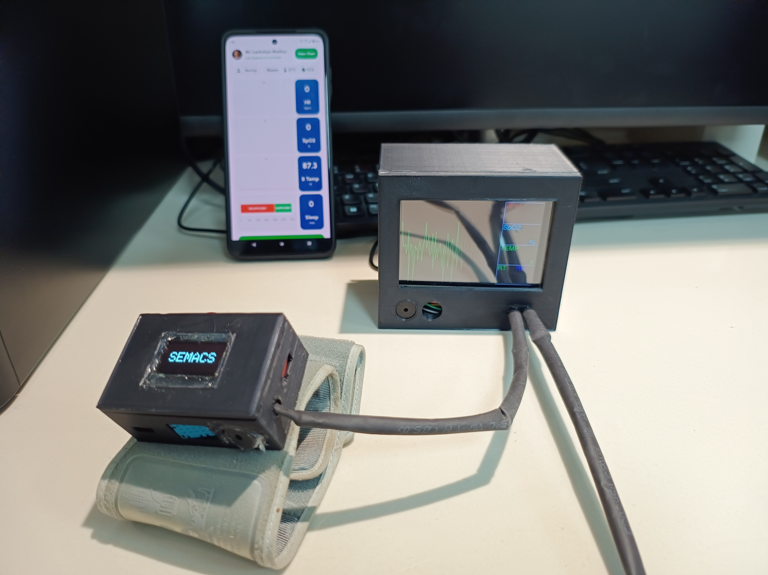
Methodology
Working Model with Mobile App Demo:

Slide 25
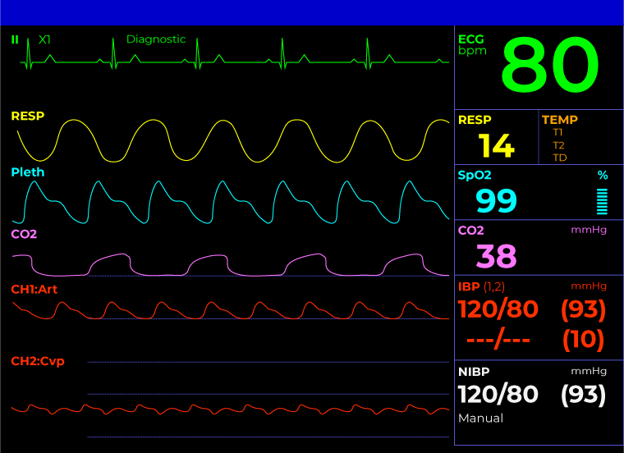
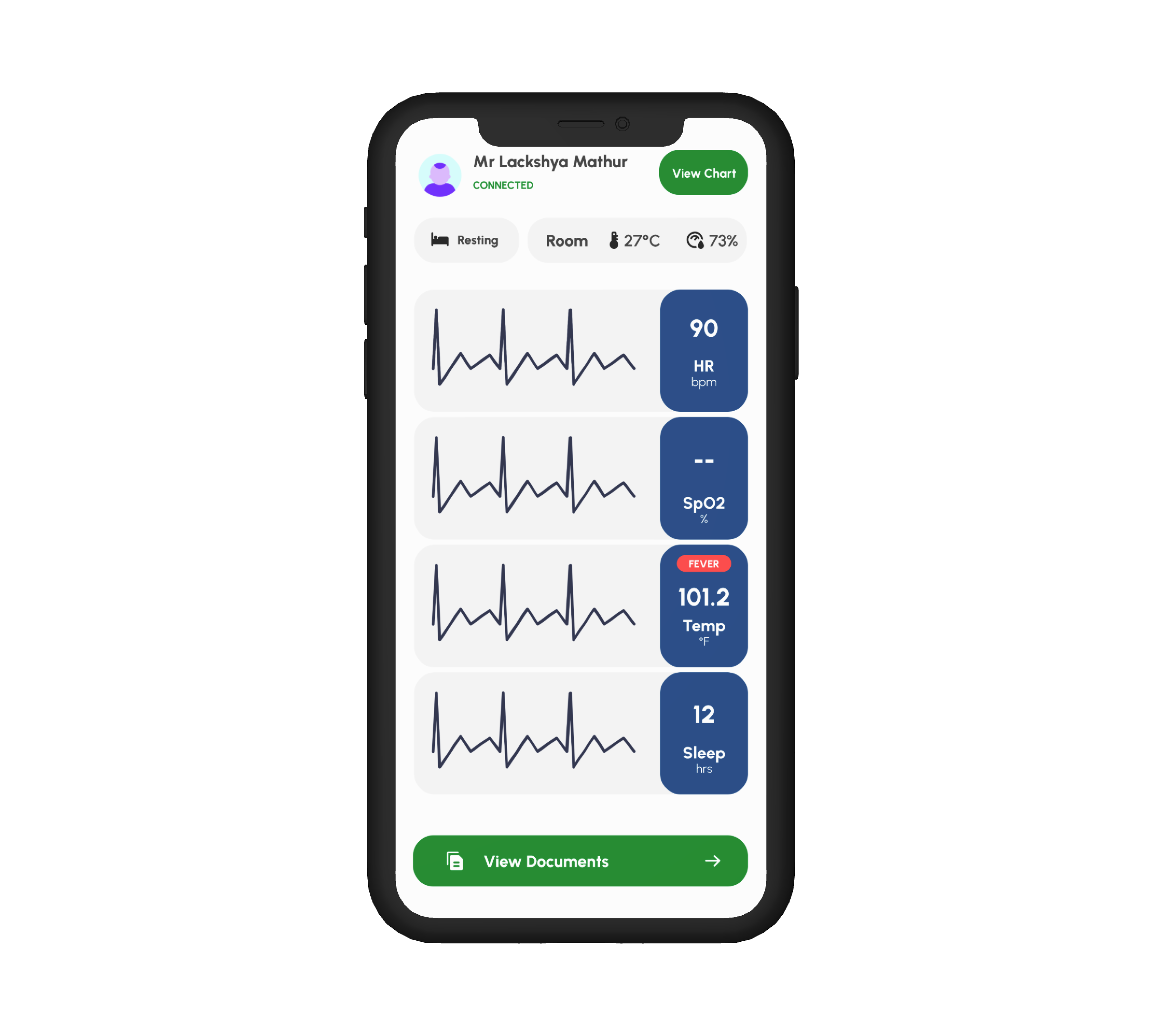
Methodology
Software (Mobile App) Design and Development:
Used Flutter and Firebase
UI resembles hospital monitors for familiarity.
Prioritize simplicity and functionality for ease.
Use graphics to visualize data.
UI has dedicated components for critical parameters (e.g., Fever).
Access patient charts conveniently.
Access patient documents like MRI, X-ray, and blood reports.
Backend ensures high uptime for reliability.

Slide 26
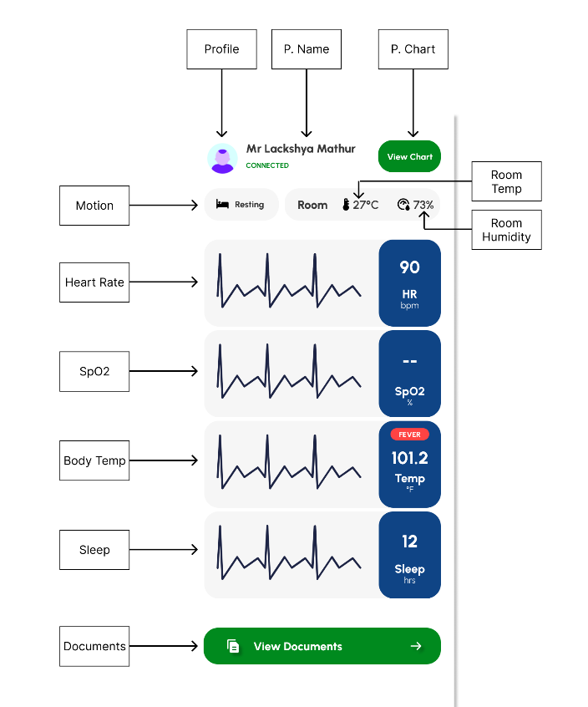
Methodology
26

Slide 27
References
[1] Smith, J., Johnson, A., & Brown, K. (2017). "Efficacy of Wearable Devices in Cardiovascular Health Monitoring." Journal of Health Technology, vol. 10, no. 2, pp. 45-56.
[2] Jones, R., Williams, B., & Davis, C. (2018). "Wearable Sensors for Sleep Monitoring: A Review." IEEE Sensors Journal, vol. 20, no. 4, pp. 1123-1132.
[3] Chen, L., Zhang, Y., & Wang, S. (2019). "Wearable Health Monitoring Technologies for Elderly Care: A Systematic Review." IEEE Transactions on Biomedical Engineering, vol. 66, no. 7, pp. 1965-1978.
[4] Wang, Q., Liu, Z., & Li, W. (2020). "Continuous Glucose Monitoring Using Wearable Sensors in Diabetes Management: A Review." IEEE Transactions on Biomedical Engineering, vol. 68, no. 3, pp. 739-752.
[5] Kim, S., Lee, H., & Park, J. (2021). "Wearable Sensors and Artificial Intelligence for Early Detection of Health Abnormalities: A Review." IEEE Journal of Biomedical and Health Informatics, vol. 25, no. 6, pp. 1885-1898.

Slide 28
Acknowledgement
We would like to extend our sincere gratitude to our Internal Faculty mentor, Prof. Manoj Sankhe, for his guidance and support throughout our project, his mentoring and guidance have given us new insights on the implementation of academic knowledge and technology which has helped us form the basis of knowledge for our future projects.
Lackshya Mathur
Nirvan Tamhane
28

Slide 29
THANK YOU
29

